Slide 1

Coffee Pass: 5 Drinks for $19.9
15/01/2026

Slide 2
Promotion Event: 「Coffee Pass: 5 Drinks for $19.9 」
Effective Date
From Jan 21 to Jan 27
Effective Scope
Promotional Products
Price: $19.9 for the Coffee Pass（tax included）. Available to all eligible participants. Limit one purchase per user.
Redeemable Items: Each voucher included in the Coffee Pass can be used to redeem one drink at any Luckin Coffee store in New York City (customization options may incur additional charges; certain store types may be excluded).
Note: If a voucher is not used within 14 days of purchase, it may be canceled and a full refund will be issued.
How to Use:
1.Purchase the Coffee Pass on the page. After completing payment, the vouchers will be added to your account.
2.Visit any Luckin Coffee store and place your drink order through the app.
3.At checkout, if the vouchers are in your account, they will be automatically applied — each voucher redeems one drink.
Refund Policy:
Refund Policy: You may request a refund at any time, provided the voucher remains unused. If a refund is needed, please send the request to our customer service email at cs@luckincoffee.us. YOUR UNUSED VOUCHER MAY BE CANCELED, AND YOU WILL RECEIVE A FULL REFUND OF THE PURCHASE PRICE IF YOUR VOUCHER REMAINS UNUSED FOR fourteen (14) DAYS OR LONGER AFTER PURCHASE AND IS CANCELED BY LUCKIN COFFEE AT ITS SOLE DISCRETION.

Slide 3
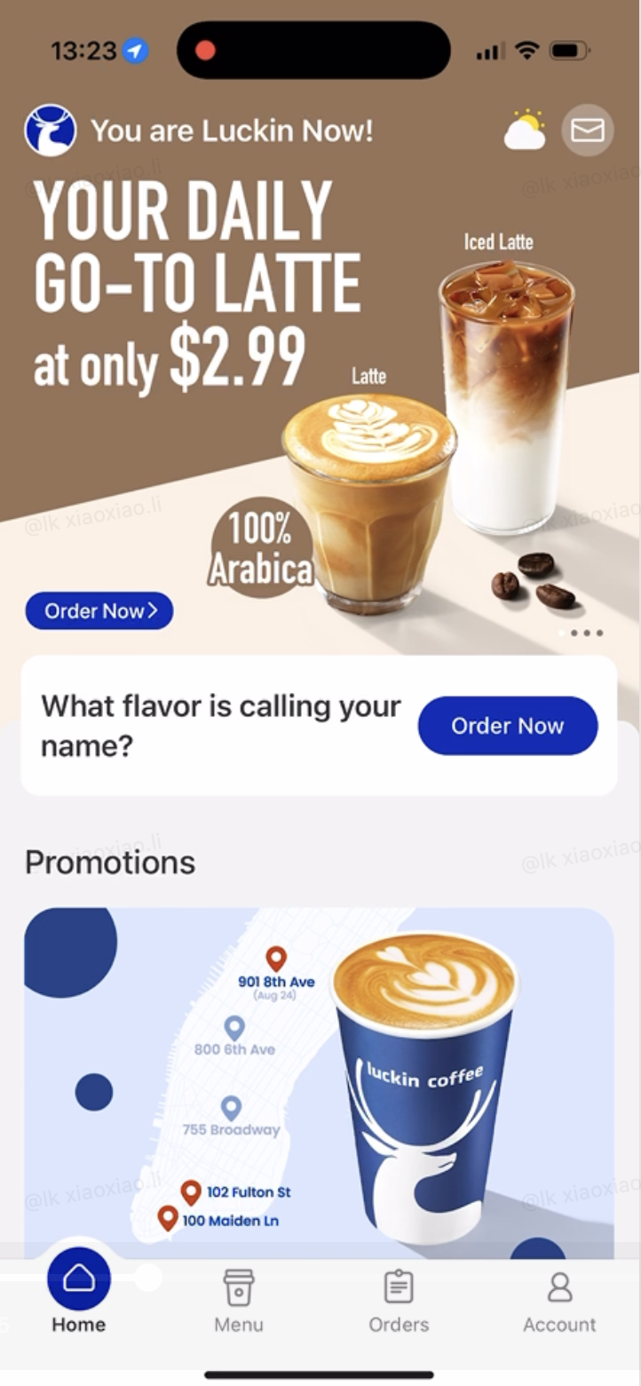
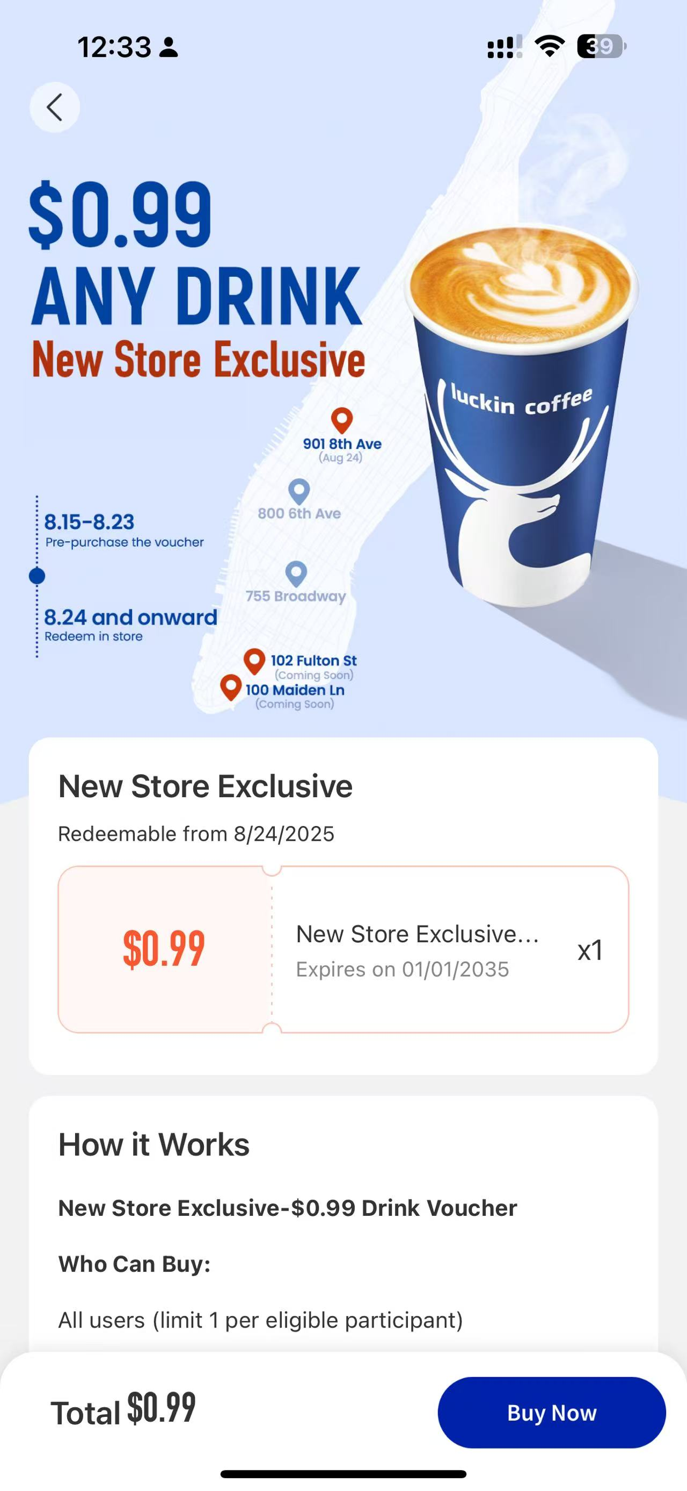
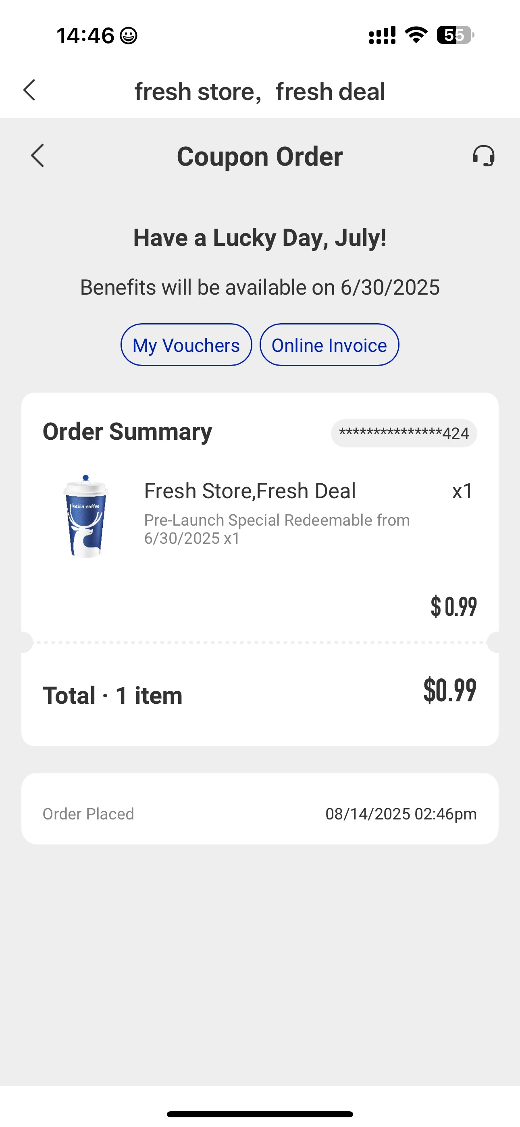
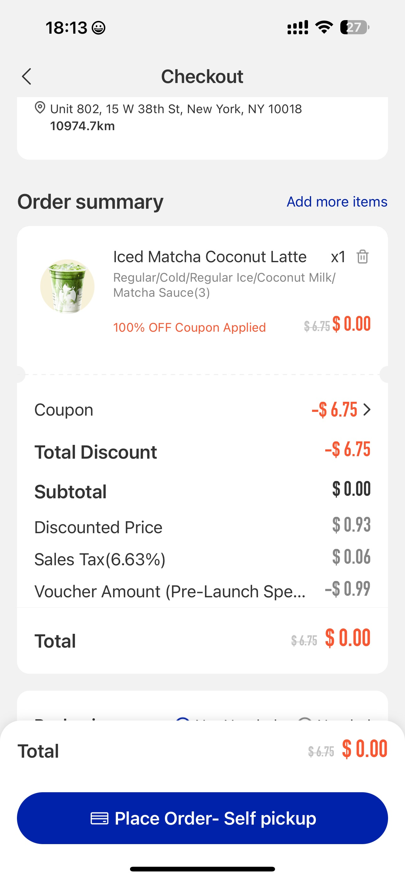
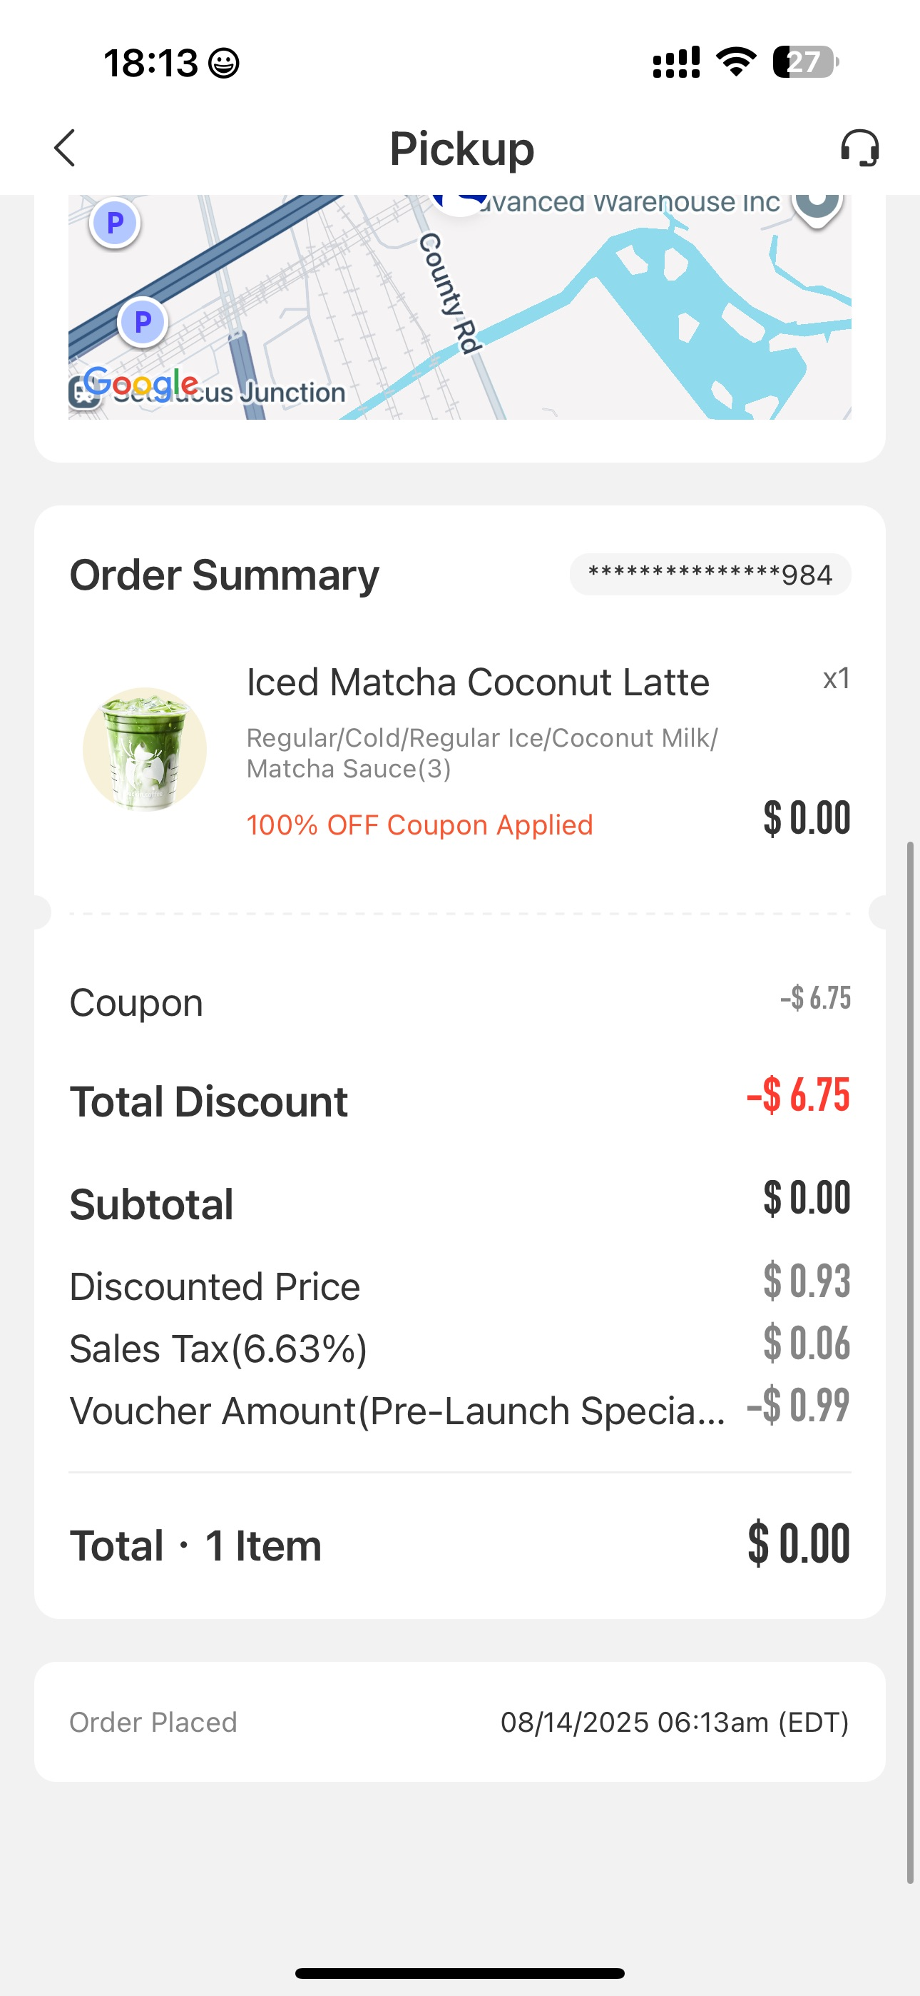

Promotion Event: 「Coffee Pass: 5 Drinks for $19.9 」
Kindly Noet:This page is for reference only. The final event details are subject to the official online page.
Purchase first
4
Redeemable right after purchase.
1
2
3
5
Event info shown on Resource positions below
Click to jump to the coffee pass purchase page
After payment, you will see the order page.
After the new store opens, starting from August 24th, you can use the voucher when placing an order.
You can check the usage status of the voucher on the order completion page.
奖品设置
* App Version Number Requirement (if any):ALL VERSION

Slide 4

Thanks!

